Slide 1
Assignment 2 Deep Learning

Slide 2
Agenda
Problem 1
Overview
Experimental Setup
Experimental Results
Evaluation
Summary
Problem 2

Slide 3
Problem 1

Slide 4
Overview
Problem 1

Slide 5
Objective
Build a sentiment analysis model to predict the emoticon for each text input

Slide 6
Dataset
dataset.csv:
the full dataset which includes text inputs and target labels •
mapping.csv:
the emoji dictionary which maps each label to an emoticon

Slide 7
Experimental Setup
Problem 1

Slide 8
Data Preprocessing
Word Embedding
Max features
50000
Max length of one sentence
34
Padding
post

Slide 9

Data Sampling
Split into data and labels
Test size
0.2
Random state
24

Slide 10
Model Development
Approach
Start with a baseline
Scale until overfit
Regularize accordingly

Slide 11
Experimental Results
Problem 1

Slide 12
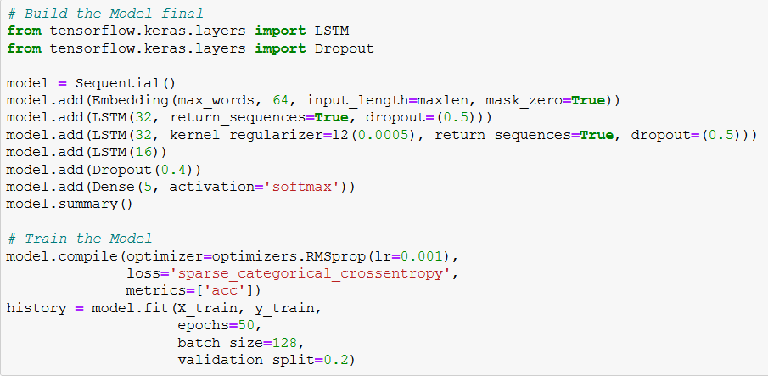
Model 1 (Final)
Word Embedding input
3 layers of LSTM
Dropout applied
Final dense layer with softmax activation

Slide 13
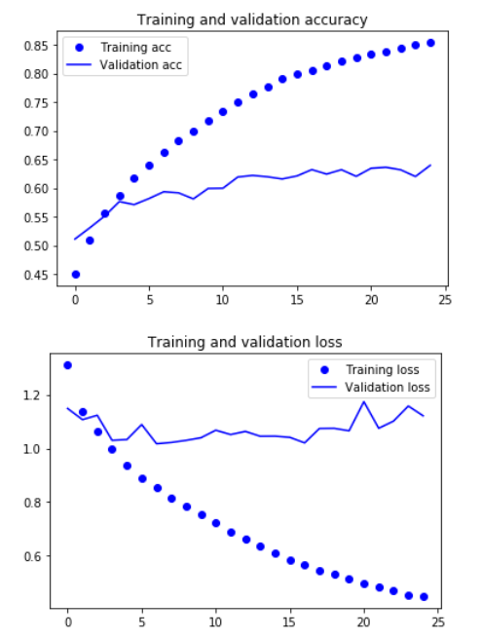
Model 1 (Final)
Overfits after a few epochs
local minima
Accuracy
~64%
Loss
1.2<
Time per epoch
~30 seconds

Slide 14
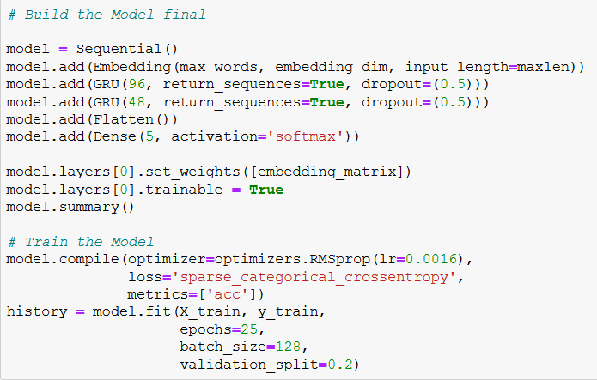
Model 2 (Final)
Word Embedding input
Pretrained on Glove
embedding_dim=50
2 layers GRU
Dropout applied
Final dense layer with softmax activation
Trained over pretrained weight
Parameters trainable
2,571,813

Slide 15
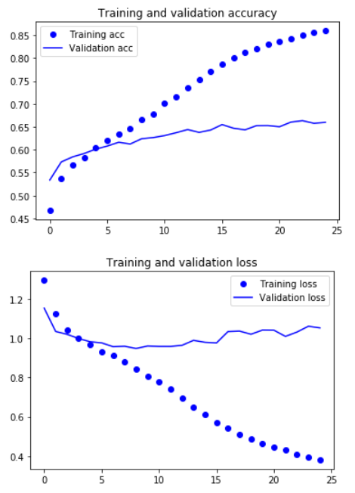
Model 2 (Final)
Overfits after 8 epochs
Accuracy
~66%
Loss
1.1<
Time per epoch
~25 seconds
Notes:
Diminishing returns after 25th epoch

Slide 16
Evaluation
Problem 1

Slide 17
Evaluation
Model 1 Final
Model 2 Final

Slide 18
Best Model (Problem 1)
Model 2 chosen
Lower loss (14.6%)
1.02 to 1.19
More confident
Higher accuracy
66% to 63%
Faster training time
25s to 30s
More computationally efficient

Slide 19





Best Model’s Predictions

Slide 20
Summary
Best model performed as expected
Non-English records could have been removed from the dataset

Slide 21
Problem 2

Slide 22
Overview
Problem 2

Slide 23
Objective
Using RNNs, create an English language text generator
character by character
semi-coherent text

Slide 24
Dataset
holmes.txt:
the full text of “The Adventures of Sherlock Holmes”

Slide 25
Experimental Setup
Problem 2

Slide 26
Data Preprocessing
Stripped all “\r” and “\n” from dataset
Removed any character that isn’t in the following image
Removed all chapter titles
Removed uploader’s mark at the end of the dataset
One-hot encoding for Model 1
Word embedding for Model 2
Notes:
After model 1 and with research, I concluded that LSTM and GRUs don’t have too big of a performance gap.

Slide 27
Model Development
Approach
Start with a baseline
Experiment until lowest loss is achieved
Regularize accordingly

Slide 28
Experimental Results
Problem 2

Slide 29
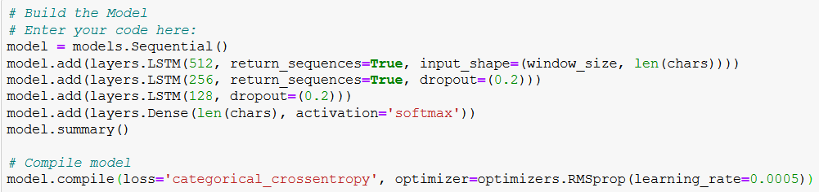
Model 1 (Final)
3 layers of LSTM
Dropout applied
Final dense layer with softmax activation
Ran for 20 epochs
12.5mins/epoch
Notes:
Diminishing returns after 23rd epoch

Slide 30
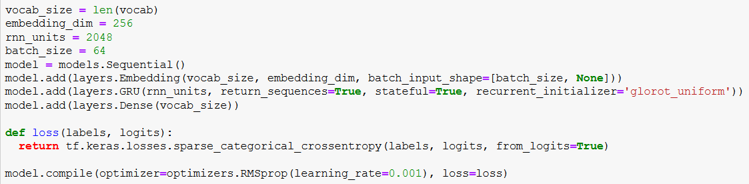
Model 2 (Final)
Word Embedding input layer
Final dense layer
Ran for 30 epochs
31s/epoch

Slide 31
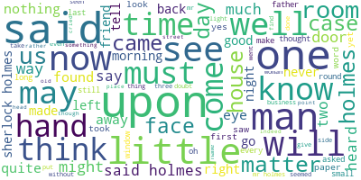
Wordcloud

Slide 32
Predictions
Chosen temperature
0.5
Not too repetitive, with some randomness

Slide 33
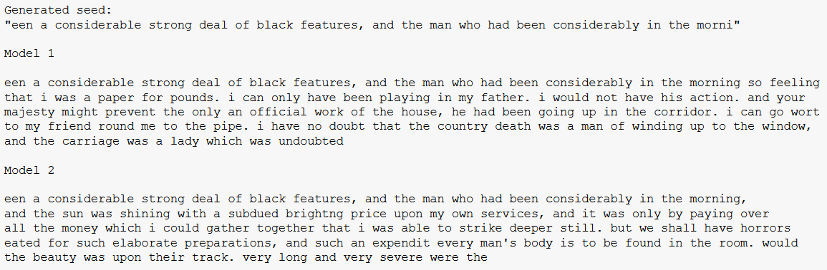
Predictions

Slide 34
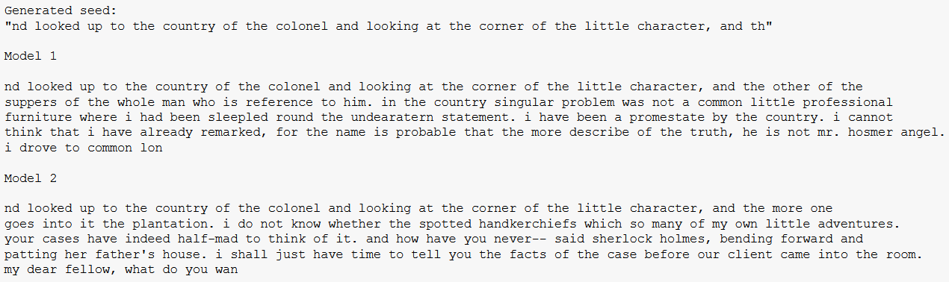
Predictions

Slide 35
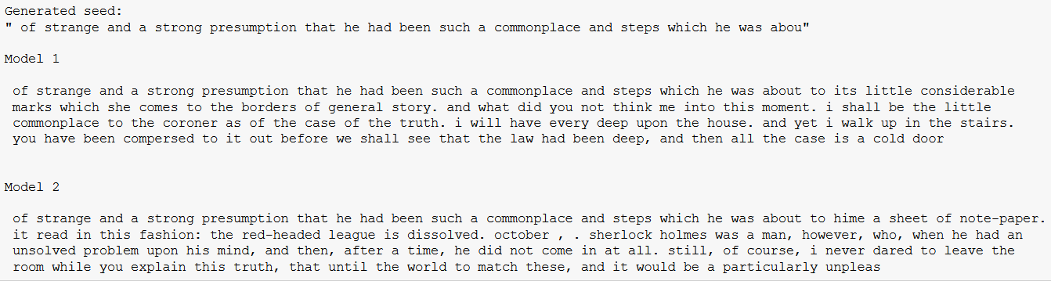
Predictions

Slide 36
Evaluation
Problem 2

Slide 37
Best Model
Model 2 chosen
Seems to follow a learnt pattern more closely compared to Model 1; semantically more sound
Undeniably much more computationally efficient
30s/epoch to 12.5mins/epoch

Slide 38
Summary
More testing could have been done
Use of external frameworks like NLP libraries could be useful
spaCy

Slide 39
Thanks!

